Slide 1

Neural operators for 2D steady-state diffusion
Geostatistics – 2025 Final project
Instructor: prof. Ivan Tyukin
Students: Ildar Saiapov, Oleg Rakhmatullin,
Arsen Andryan, Tatiana Kobernik, Mahina Spirina
Skoltech 2025

Slide 2



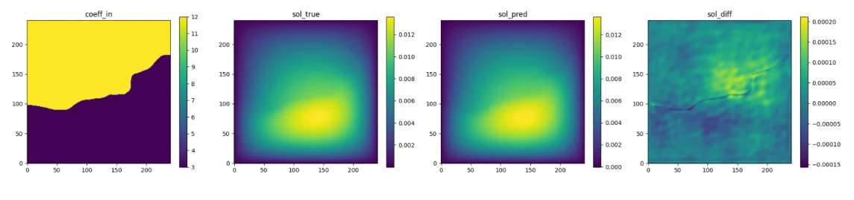
ConDiff dataset
cover a set of PDEs, both steady-state and time-dependent, with different resolutions and time lengths
We consider a 2D steady-state diffusion equation
In our project we have considered the next solvers:
FNO and it`s modified AFNO and IAFNO
DilResNet
CNN + transformer
PITT
(Left to right) Input permeability, true pressure, predicted pressure, error

Slide 3
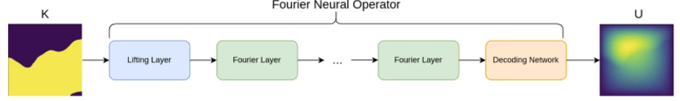


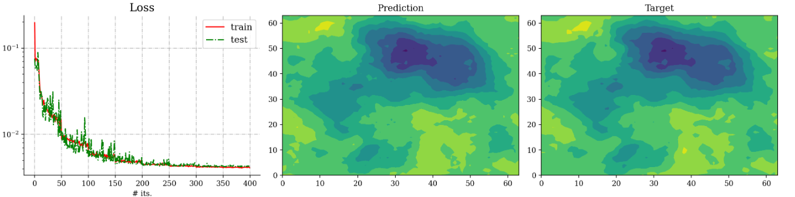
Fourier Neural Operator
Key features
data-driven architecture
the spectral convolutions
skip connections
FNO surrogate model for 2D Darcy flow
1) The spectral convolution (Fourier integral operator)
Result of the training:
2) The FNO model is a the composition of the next:
Decoding network
L spectral convolutions
Lifting” layer

Slide 4
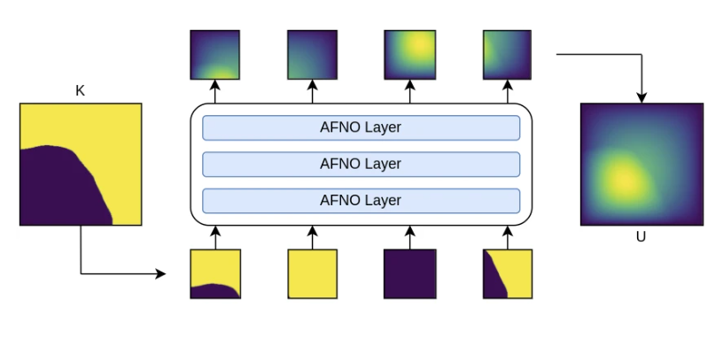




Adaptive Fourier Neural Operator
Key features
For high-resolution inputs
Combines FNO with the Vision Transformer (ViT)
The own self-attention mechanism
The AFNO architecture implements the following operations in each layer:
1) TT transformed in FD
2) Token weighting in FD and promoting sparsity
AFNO surrogate model for 2D Darcy flow
3) The last operation in a ANFO layer is an inverse Fourier to transform back
Result:
Key tuned hyperparameters:
num_blocks
λ (sparsity)
n_layers
….

Slide 5
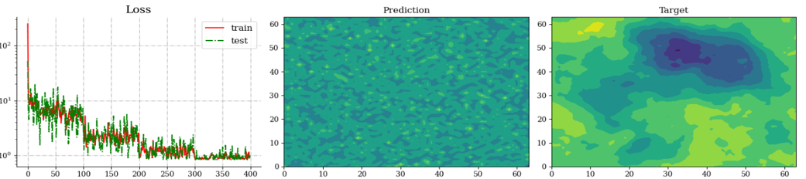
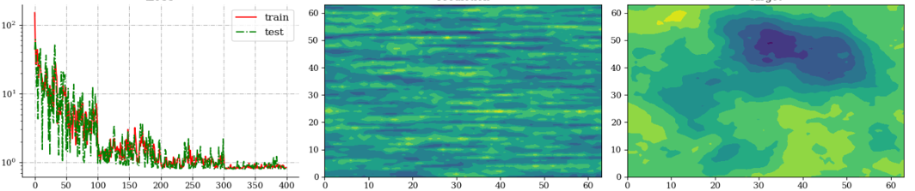
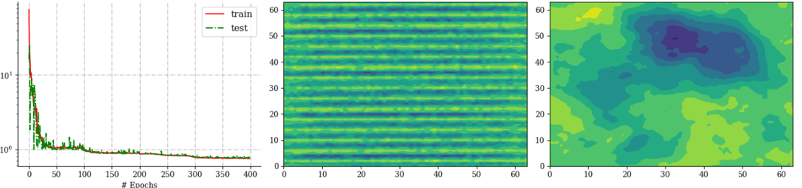

Slide 6
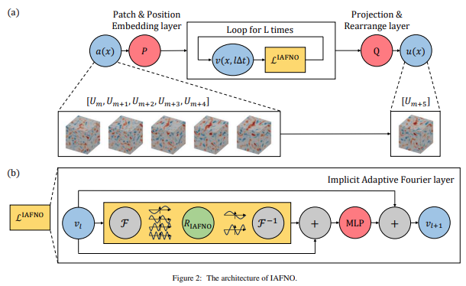


Implicit Adaptive Fourier Neural Operator
Key features
Implicit Adaptive Fourier Layer
Each block runs n_{imp} fixed-point iterations
combining adaptive spectral modes (contrast-driven sparsity) with residual updates
Curriculum learning by contrast
Training starts on low-contrast permeability maps and gradually introduces harder, high-contrast cases
Coefficient-field augmentation
Random flips and transposes on the input maps boost robustness to geometric variations
Define Z₀ = Cᵢₙ(X) For each block l=1…D do: S = Spec(Z_{l−1}); L = Loc(Z_{l−1}); V = S + L; M = MLP(V) T = θ·Z_{l−1} + (1–θ)·M Z_l = N(T) Finally, Y = Cₒᵤₜ(Z_D + Z₀)
Legend: X – input tensor (forcing term + coords) Cᵢₙ – initial 1×1 convolution Spec – adaptive FFT-based spectral convolution Loc – 3×3 local convolution MLP – two 1×1 convolutions with GELU θ – learnable gating scalar N – GroupNorm Cₒᵤₜ – final 1×1 convolution Y – model output
Physics-Informed Loss

Slide 7
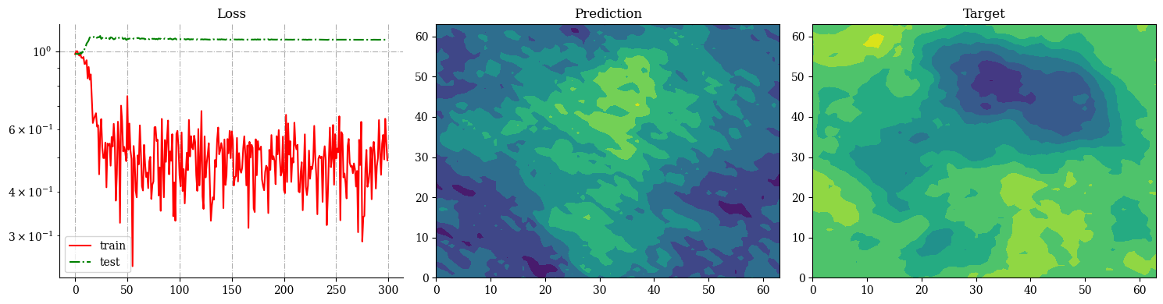
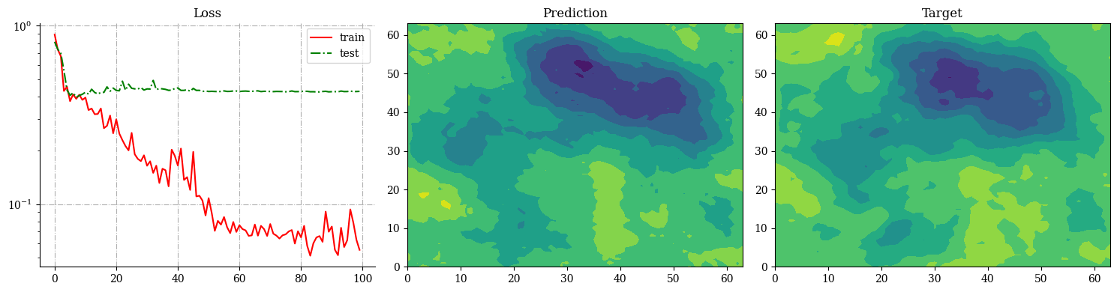
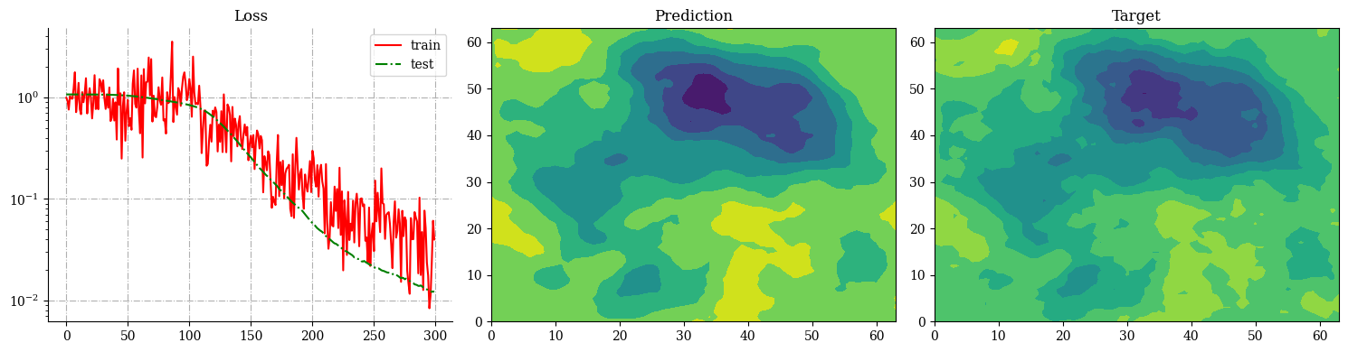
IAFNO test error: 0.676 ± 0.132
IAFNO test error: 0.429 ± 0.155
IAFNO test error: 0.152 ± 0.043

Slide 8
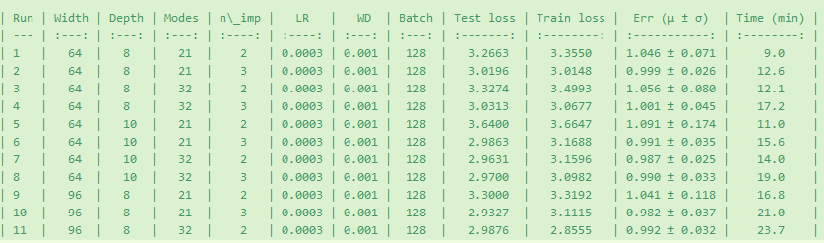

Slide 9
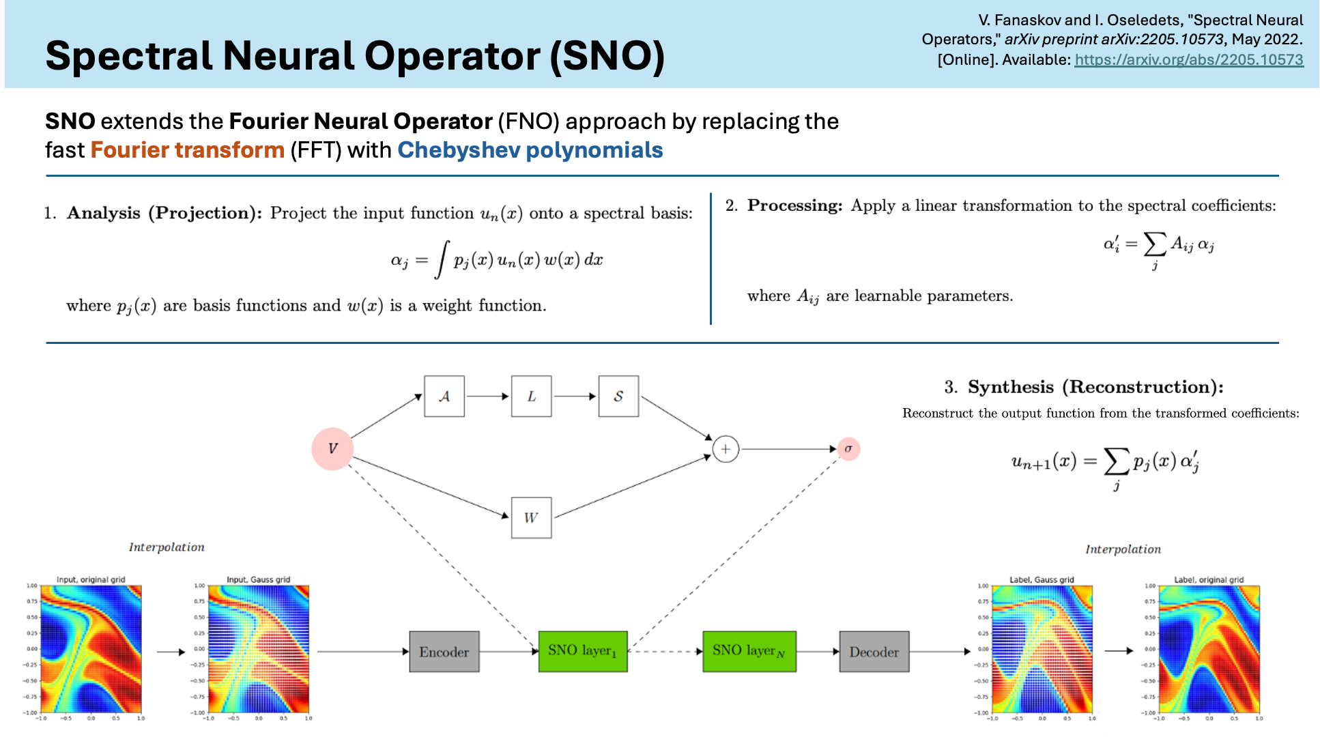

Slide 10
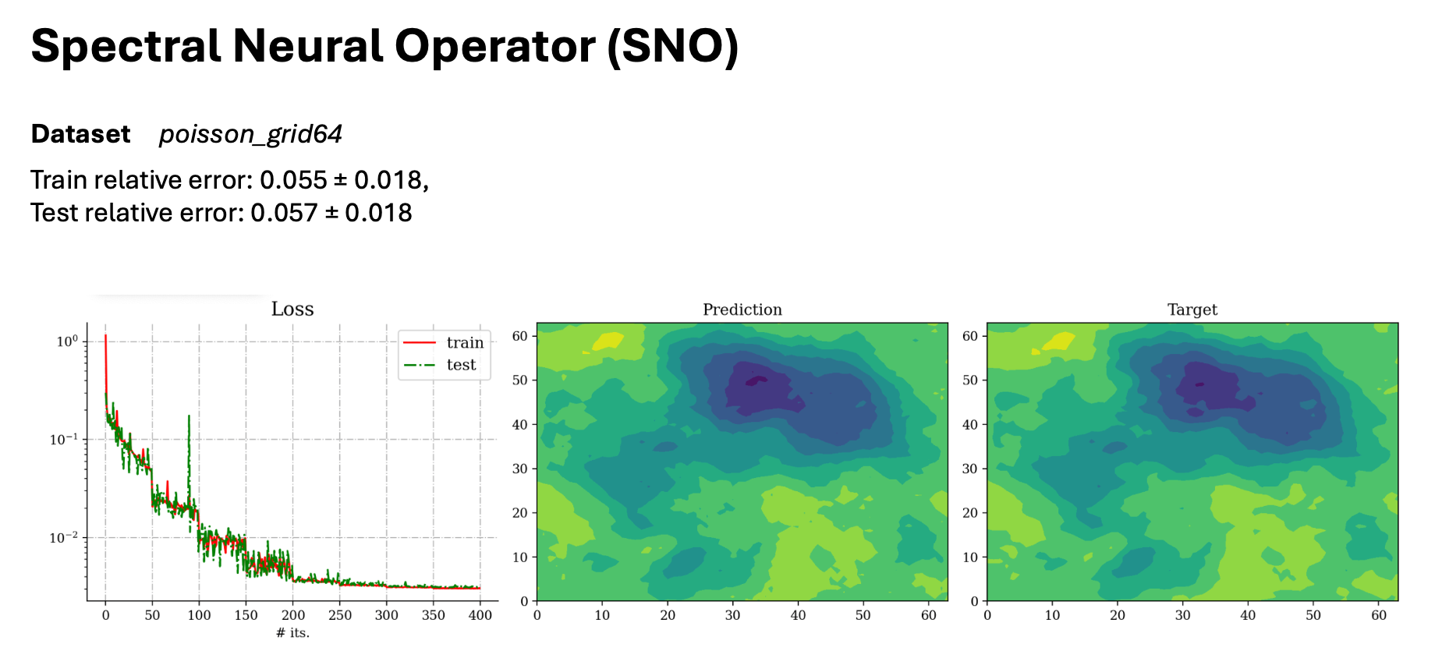

Slide 11
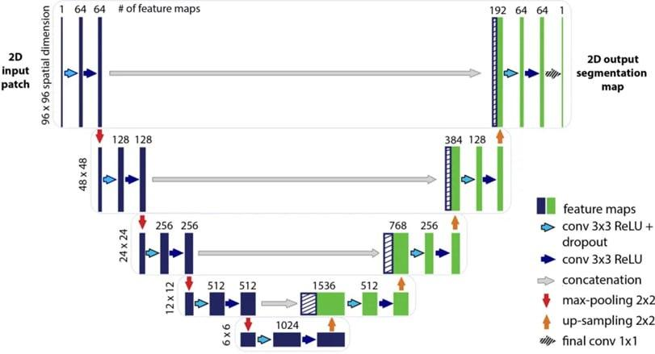
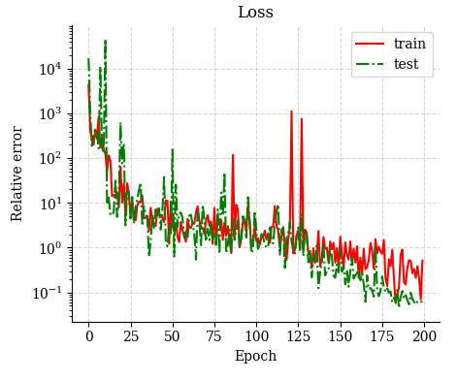
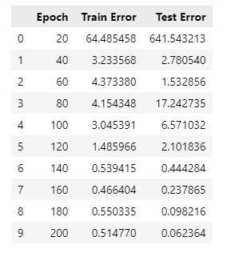
U-Net Surrogate for 2D Steady-State Diffusion
Motivation
Replace heavy spectral models
U-Net is easy to train and widely used in image-to-image regression
Why U-Net for PDEs?
Maps 2D input → 2D output, ideal for PDE fields
Captures both local and global features
Skip connections preserve fine spatial detail
Fast, stable, and easy to train
Strong baseline vs. spectral models
Test error: 0.102 ± 0.031 on poisson_grid64
✔ Consistent convergence ✔ No overfitting ✔ Good structure recovery

Slide 12
